Slide 1
RX CALIBRATION RESULTS
Javier C. Linde, Maxim Kulesh & RX team: Abhijeet , Yuan Gao, Juan Osario
July 2022

Slide 2
Management summary
RX IF Calibration was delayed heavily (3 – 4 months in comparison to other calibrations)
Relatively high algorithmic complexity
High interdependence and harmony between multiple IPs (TE, RXBIST, RX, ADC, PDC, WDMA, etc.)
Resources (at the beginning) were also allocated to other tasks
Metal fix was required to enable CW mode for RX
Current working version (branch STRX-4294) is presented in this document.
Results are satisfactory, but at the cost of very long execution time.

Slide 3
Management Summary (cont.)
Three step proposal:
Release current version to Validation. 3-4 (+ Pull Requests + Proxy) days of focused work:
Selecting number of iterations per step,
create simplified API ( _validate functions),
create extended API (e.g. frequency sweep for transfer function analysis)
reporting final error
Access to both open-loop and closed-loop
Finalize current version for integration into RFE SW before September. Part-time Javier (and Maxim):
Restoring TE, RX and other settings for functional mode after calibration
Refactoring of code (many common items with RX BIST Safety tests functionality)
Integrating finished SW Units (e.g. WDMA) into calibration vs raw SPI read / write commands.
Documentation (Enterprise Architect), Manual, etc.
Improve calibration before ES2 (December). Part-time Javier (and Maxim)_. Main attention points:
Optimizing the timing. (e.g. Measuring WDMA latency via interrupts), select number of iterations per step based on extensive validation
Improving SNR by amplifying signal to full dynamic range of RX / ADC (RX BIST validation is required)
Enabling calibration on multiple RXs (currently only Rx1), etc.
Validation
Denso

Slide 4
Management Summary (cont.)
Proposal from Dominique:
Focus on Denso use-case only
Finalize full calibration before September (Denso expects before September all calibration)
Validation
Denso

Slide 5
Calibration walkthrough

Slide 6
CALibratioN SETUP
RX Targets:
HPF = 800kHz
HPF1 = 400KHz
HPF2 = 1183KHz
LPF = 25MHz
Gain = 46dB
Gain1 = 20dB = 10.00 (linear)
Gain2 = 17dB = 7.079 (linear)
IF Calibration:
Number of iterations: 2 (per Rf, Cf, Cin & Rlpf)
Number of samples: 512 (per iteration)
VCO:
Frequency = 77GHz
CW mode (bandwidth 0)
Jumpback = 10 (x25ns)
Reset = 10 (x25ns)
Timing Engine:
Dwell = 10 (x25ns)
Settle = 10 (x25ns)
PowerOnDelay = 40 (x25ns)
Acquisition based on the number of samples (see next slides)
(Pre-) Calibrations:
VCO, LOI RX, RX LOX2, RX BIST LOX2, RX BIST SSB are all calibrated using API.

Slide 7
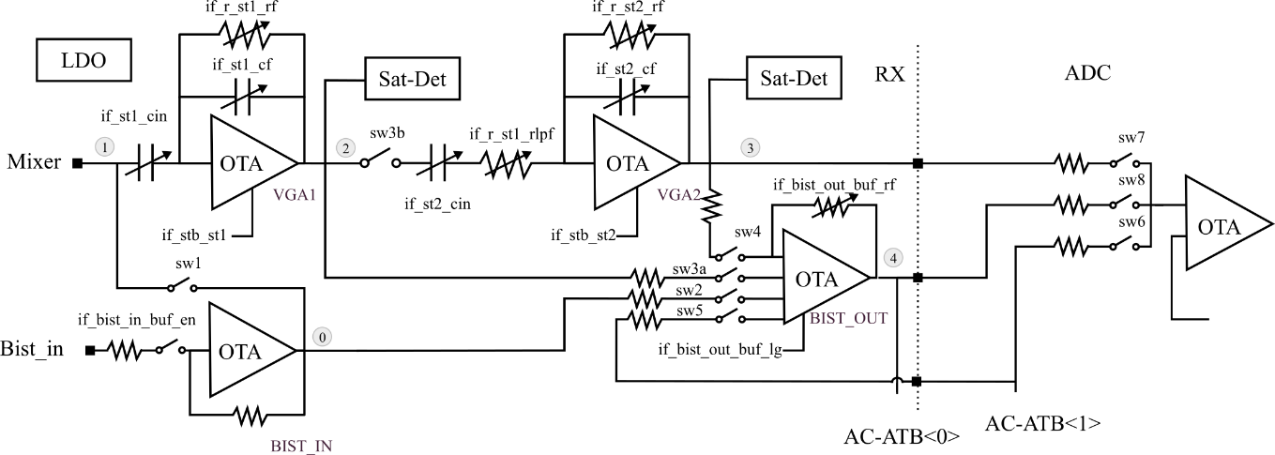
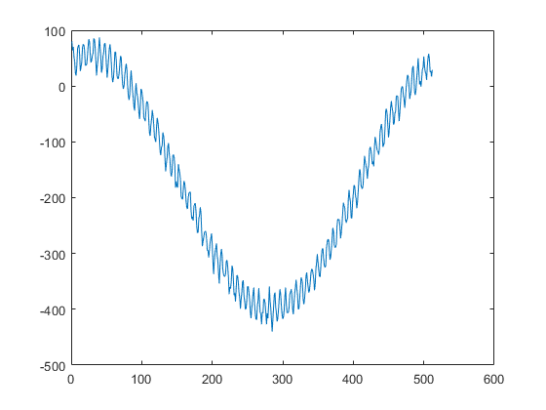
I. BIST-to-ADC Reference Measurement
Selected tones:
F1 = max(Fres; 0.1x Fhp) = 78.125kHz
F2 = sqrt(1.414 x Fhp x Flp) = 5312.5kHz
-- plateau
Mode4 configuration
Measurement: Bin1 = 114.09, Bin68 = 12.18
Wrong DFT scaling,
But no impact on calibration

Slide 8
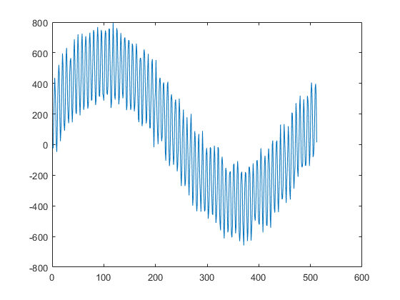
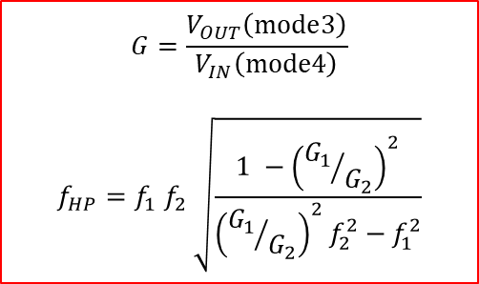
II. STAGE1 HPF & GAIN CALIBRATION DIfferential STRATEGy
==== Nominal settings
Measurement: Bin1 = 270.75, Bin68 =129.63
HPF measured*: 342223Hz
==== RF Code: 21 ==> 21 (no change)
Measurement: Bin1 = 271.63, Bin68 = 132.09
HPF measured: 347901Hz
==== RF Code: 21 ==>:21 (no change)
Measurement: Bin1 = 270.63, Bin68 = 131.15
HPF measured: 346615Hz
==== Cf code: 12 ==> 7
Measurement: Bin1 = 272.21, Bin68 = 151.46
HPF measured: 400726Hz
==== Cf code: 7 ==> 7 (no change)
Measurement: Bin1 = 273.84, Bin68 = 150.27
HPF final: 394940Hz
Gain measured: 12.37 (linear)
==== Cin code:127 ==> 83
Measurement: Bin1 = 222.00, Bin68 = 121.00
Gain measured: 9.95
==== Cin code: 83 ==> 84 (change of 1)
Measurement: Bin1 = 223.82, Bin68 = 122.54
Gain final: 10.09 (linear) = 20.07dB
Mode3 configuration
$$G=\frac{V_{OUT}\left(mode3\right)}{V_{IN}\left(mode4\right)}$$
$$f_{HP}=f_{1} f_{2} \sqrt{\frac{1 −{\left({G_{1}}/{G_{2}}\right)}^{2}}{{\left({G_{1}}/{G_{2}}\right)}^{2}f_{2}^{2}−f_{1}^{2}}}$$
Final:
*Log for demonstration only. In firmware, hpf and gain are estimated at the same time in every loop

Slide 9
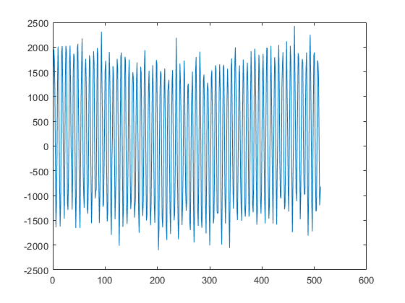
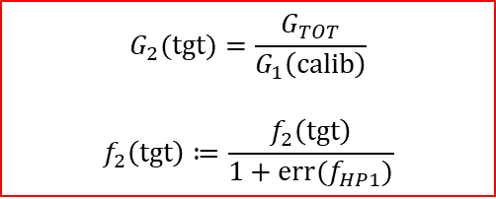
III. STAGE2 HPF & GAIN CALIBRATION DIfferential STRATEGy
==== Nominal settings (stage2)
Measurement: Bin1 = 132.28, Bin68 = 845.13
HPF measured*: 923035Hz
==== RF Code: 19 ==> 18
Measurement: Bin1 = 114.55, Bin68 = 853.78
HPF measured: 1083832Hz
==== RF Code: 18 ==>: 18 (no change)
Measurement: Bin1 = 111.32, Bin68 = 835.54
HPF measured: 1091868Hz
==== Cf code: 28 ==> 23
Measurement: Bin1 = 110.84, Bin68 = 938.93
HPF measured: 1240206Hz
==== Cf code: 23 ==> 25
Measurement: Bin1 = 111.77, Bin68 = 900.42
HPF final: 1176136Hz
Gain measured: 7.55 (linear)
==== Cin code:127 ==> 111
Measurement: Bin1 = 103.70, Bin68 = 841.95
Gain measured: 7.04
==== Cin code: 111 ==> 110 (change of 1)
Measurement: Bin1 = 100.62, Bin68 = 844.22
Gain final: 7.07 (linear) = 16.99dB
Mode2 configuration
Compensation of stage1 error:
$$G_{2}(tgt)=\frac{G_{TOT}}{G_{1}\left(calib\right)}$$
$$f_{2}\left(tgt\right)≔\frac{f_{2}\left(tgt\right)}{1+err(f_{HP1})}$$
Full dynamic range of RX / ADC is not exploited
HPF2 target: 119815Hz
Gain2 target: 7.018
Final:

Slide 10
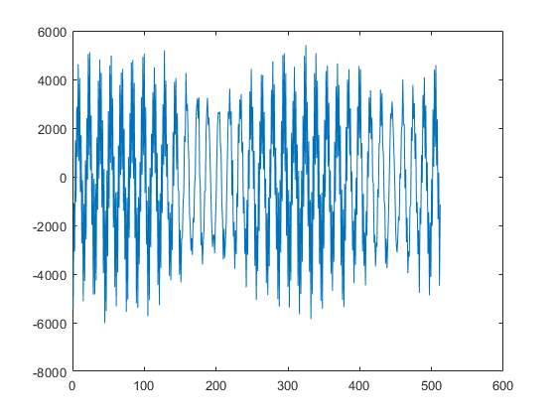
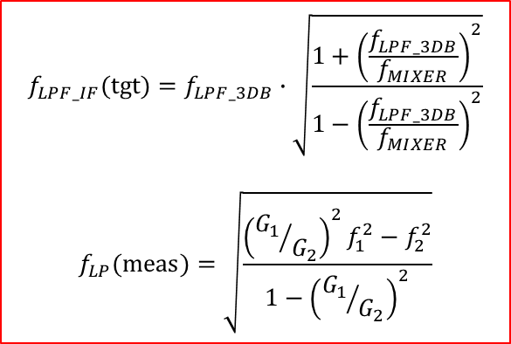
IV. IF LPF measurement de-embedding IF LPF for Mixer pole estimation (next step)
PDC reprogrammed to 80Msps
RX BIST reprogrammed. New tones:
F1 = sqrt(1.414 x Fhp x Flp) = 5.31kHz
F2 = min(Fs/2 – Fres; 10x Flp) = 39.92MHz
==================================
Mixer (nominal): 125MHz
F_{LP_IF}(tgt): 26.02MHz
==== RLPF code: 511(WB) ==> 91
Measurement (mode3): Bin34 = 228.61,
Bin255 = 309.05
Measurement (mode2): Bin34 = 1520.95,
Bin255 = 1156.60
IF LPF measured: 25 279 870Hz
Not really a calibration as we stop here.
IF LPF target based on mixer:
$$f_{LPF_IF}(tgt)=f_{LPF_3DB}∙\sqrt{\frac{1+{\left(\frac{f_{LPF_3DB}}{f_{MIXER}}\right)}^{2}}{1−{\left(\frac{f_{LPF_3DB}}{f_{MIXER}}\right)}^{2}}}$$
$$f_{LP}(meas)=\sqrt{\frac{{\left({G_{1}}/{G_{2}}\right)}^{2}f_{1}^{2}−f_{2}^{2}}{1−{\left({G_{1}}/{G_{2}}\right)}^{2}}}$$
Final (mode2):

Slide 11
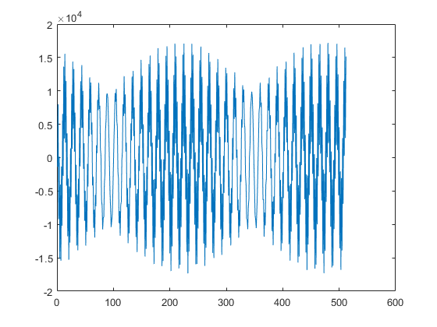
V. MIXER ESTIMATION AND FINAL IF LPF CALIBRATION
RX BIST reprogrammed to RF Mode
Measurement (mode5): Bin34 = 4941.70
Bin68 = 3608.17
Mixer pole measured: 135 555 120Hz
IF LPF Target: 25.86MHz (new)
==== RLPF Code: 91 ==> 94
Measurement (mode5): Bin34 = 4970.18
Bin255 = 3693.05
IF LPF measured : 25 952 87Hz
Final:

Slide 12
Statistical results

Slide 13
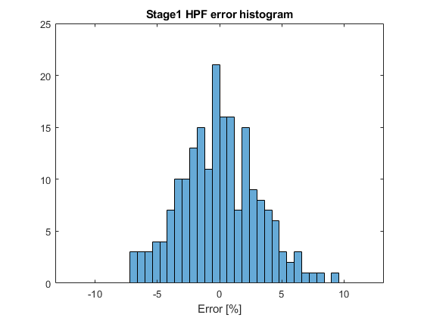
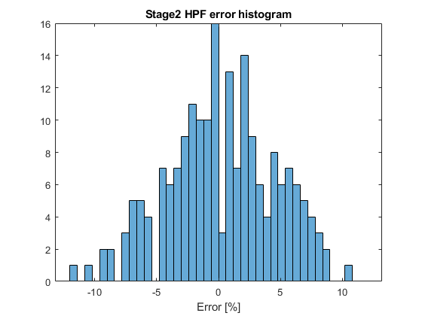
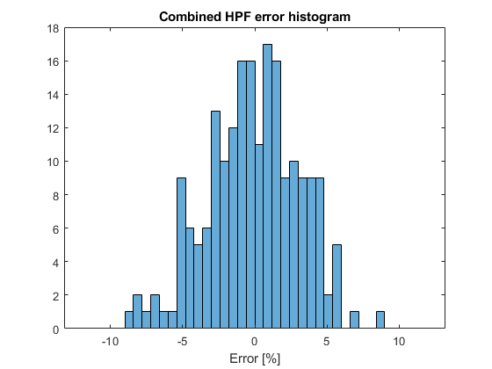
Calibrate Results: HPF As MEASURED USING INTERNAL PROCEDURE, not externally !!!
# of runs = 200
N = 512 samples
Combined is estimated from hpf1 and hpf2
Std = 3.12%
Std = 4.61%
Std = 3.19%

Slide 14
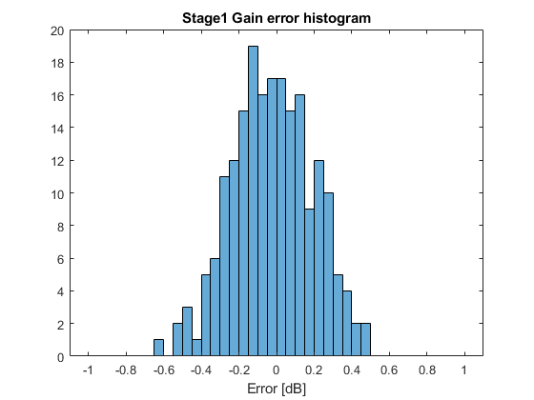
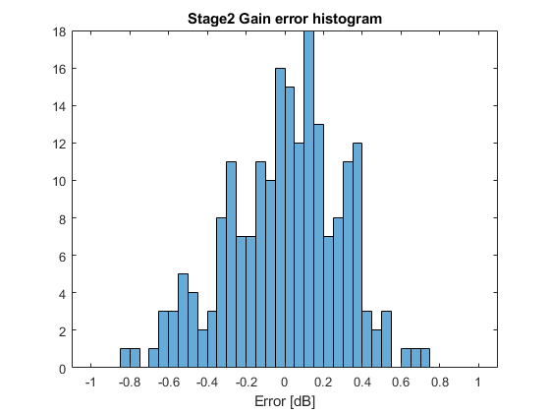
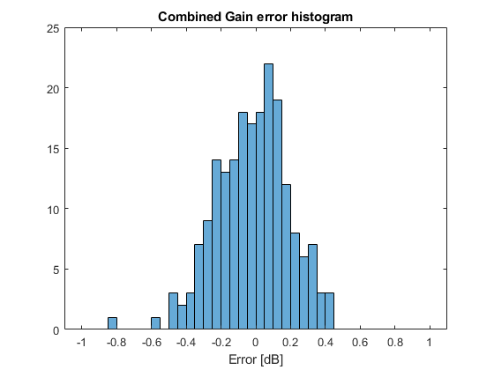
Calibrate Results: GAIN As MEASURED USING INTERNAL PROCEDURE, not externally !!!
# of runs = 200
N = 512 samples
Combined is estimated from gain1 and gain2
Std = 0.22dB
Std = 0.29dB
Std = 0.21dB

Slide 15
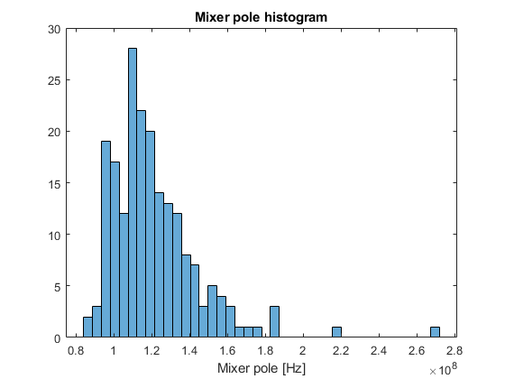
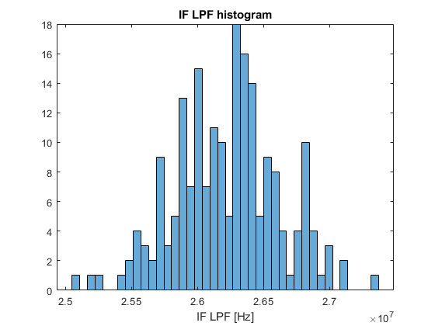
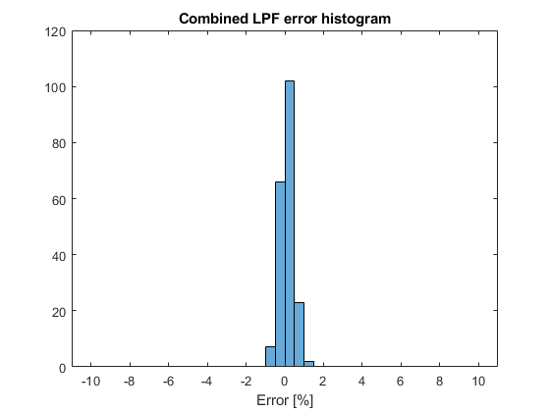
Calibrate Results: LPF As MEASURED USING INTERNAL PROCEDURE, not externally !!!
# of runs = 200
N = 512 samples
IF LPF target is based on Mixer pole estimation. Therefore, looking at combined error always results in low value. It doesn’t indicate that the combined LPF is correct. However, it can be concluded that IF LPF bist measurement and IF LPF quantization error is low!
Std = 23.28MHz
Std = 392kHz
Std = 0.35%
It can be clearly seen that Mixer pole accuracy has limited impact on final IF LPF calibration target (at least for OneChip). As the difference between 100MHz and 200MHz mixer pole is only 0.2dB at 25MHz

Slide 16
Impact of samples number on calibration results

Slide 17
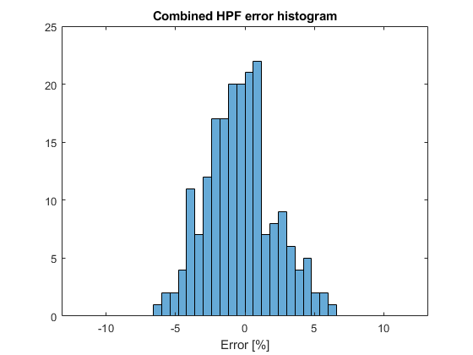
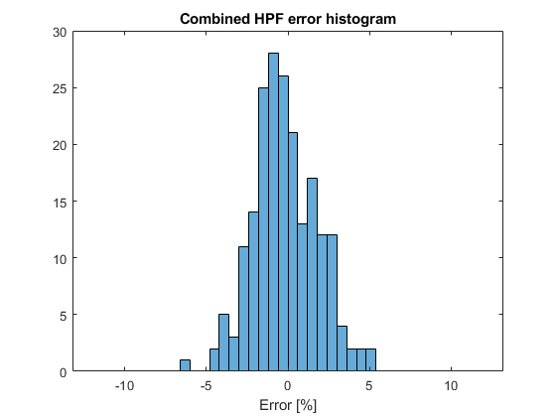
Calibrate Results: HPF As MEASURED USING INTERNAL PROCEDURE, not externally !!!
# of runs = 200
N = 512 samples
N = 1024 samples
N = 2048 samples
Std = 3.19%
Std = 2.43%
Std = 1.92%

Slide 18
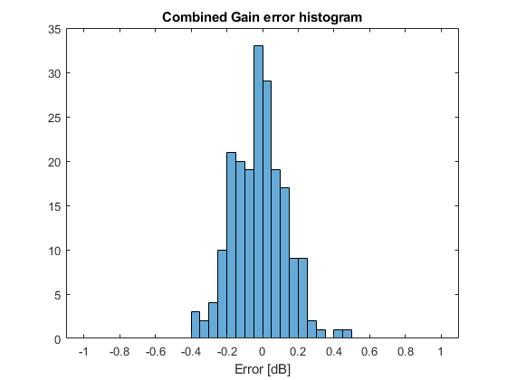
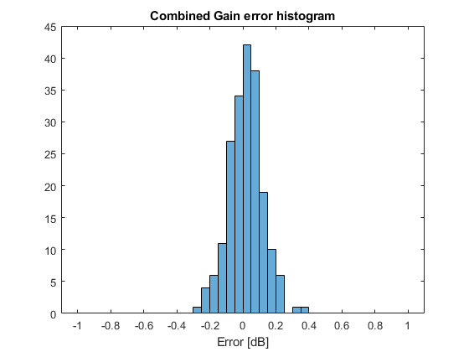
Calibrate Results: GAIN As MEASURED USING INTERNAL PROCEDURE, not externally !!!
# of runs = 200
N = 512 samples
N = 1024 samples
N = 2048 samples
Std = 0.21dB
Std = 0.14dB
Std = 0.10dB
1 / sqrt(2)
1 / sqrt(2)
*Random noise

Slide 19
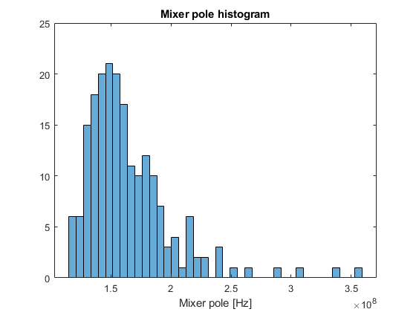
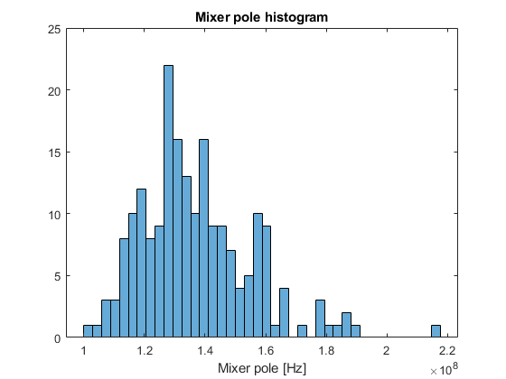
Calibrate Results: MIXER POLE !!! As MEASURED USING INTERNAL PROCEDURE, not externally !!!
# of runs = 200
N = 512 samples
N = 1024 samples
N = 2048 samples
Mean = 121MHz
Min = 86.8MHz
Max = 271MHz
Mean = 164MHz
Min = 116MHz
Max = 335MHz
Mean = 137MHz
Min = 100MHz
Max = 217MHz

Slide 20
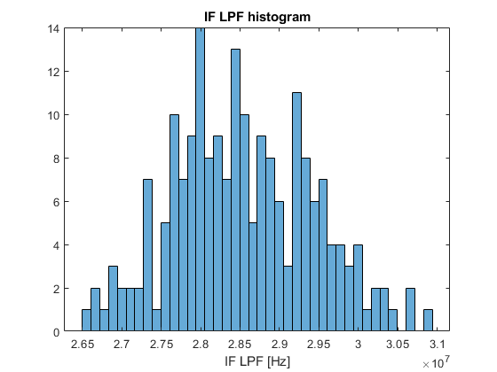
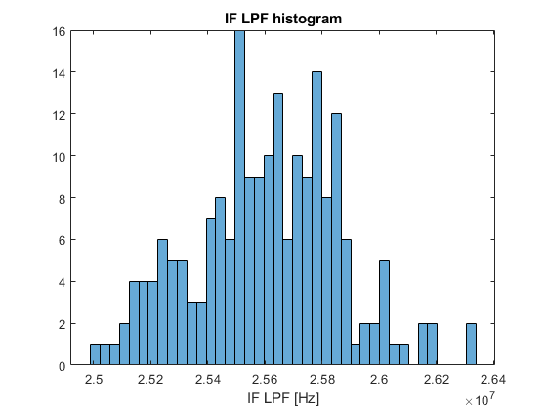
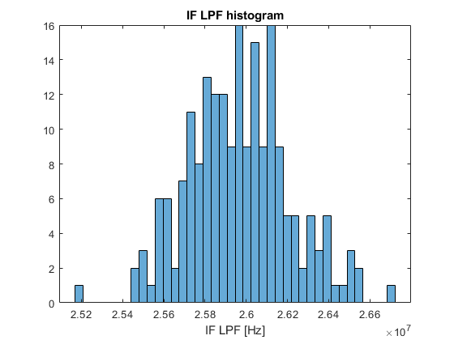
Calibrate Results: IF LPF As MEASURED USING INTERNAL PROCEDURE, not externally !!!
# of runs = 200
N = 512 samples
N = 1024 samples
N = 2048 samples
Mean = 28.5MHz
Min = 26.5MHz
Max = 30.9MHz
Mean = 25.6MHz
Min = 25.0MHz
Max = 26.3MHz
Mean = 26.0MHz
Min = 25.2MHz
Max = 26.7MHz

Slide 21
Issues with 4096 samples

Slide 22
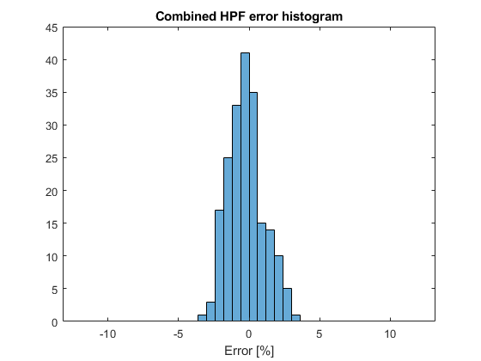
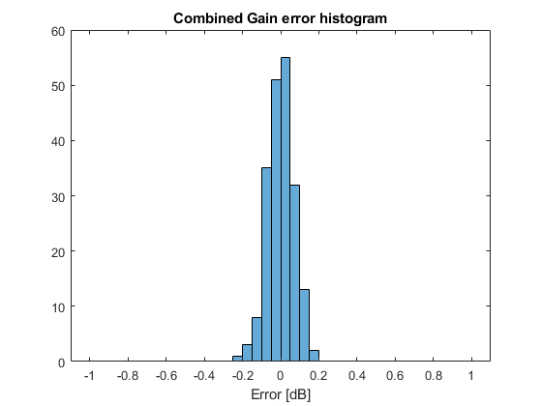
Calibrate Results: 4096 samples As MEASURED USING INTERNAL PROCEDURE, not externally !!!
# of runs = 200
N = 4096 samples
No issues with HPF and Gain calibration
Std = 1.26%
Std = 0.07dB

Slide 23
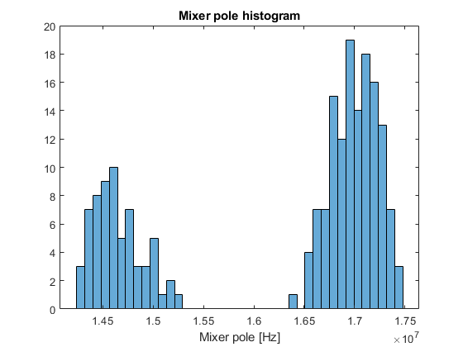
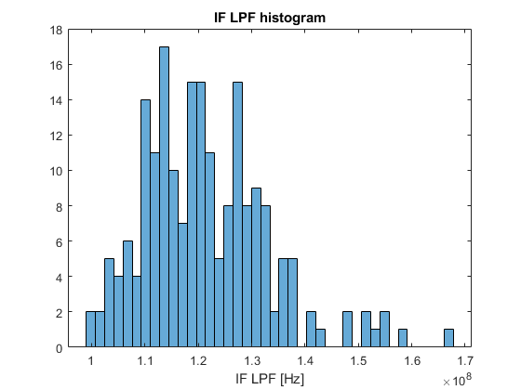
Calibrate Results: 4096 samples As MEASURED USING INTERNAL PROCEDURE, not externally !!!
# of runs = 200
N = 4096 samples
Issues with RF calibration (mixer pole and as the result IF LPF calibration)
Mean = XXX
Min = 14.2MHz
Max = 17.5MHz
Mean = 121MHz
Min = 99MHz
Max = 167MHz

Slide 24
Calibrate Results: 4096 samples As MEASURED USING INTERNAL PROCEDURE, not externally !!!
The issue was identified. Insufficient wait time after triggering timing engine. It seems that wait time is not proportional to number of samples (WDMA latency?)

Slide 25
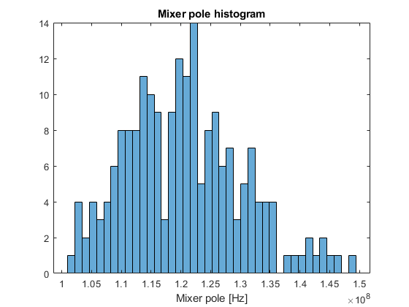
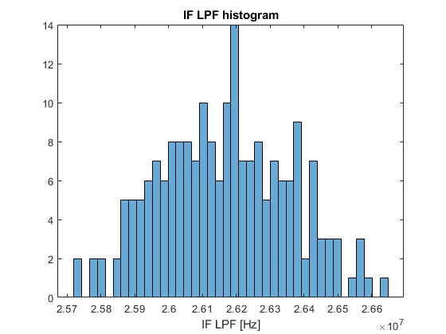
Calibrate Results: 4096 samples As MEASURED USING INTERNAL PROCEDURE, not externally !!!
# of runs = 200
N = 4096 samples
Wait time of 10ms (from 100us)
Mean = 120MHz
Min = 101MHz
Max = 149MHz
Mean = 26.2MHz
Min = 25.7MHz
Max = 26.6MHz

Slide 26
CONCLUSIONS & STEP FORWARDS

Slide 27
Conclusions
Increasing number of samples increases accuracy across the board:
HPF, Gain, IF LPF and mixer pole estimation
Improving mixer pole estimation gives diminishing returns. Spread of final IF LPF doesn’t change drastically. For example, delta between 100 and 200MHz of mixer pole is 0.2dB at 25MHz
Number of iterations per each step must be investigated
Timing required for WDMA to write the of samples should be measured for timing optimization
Calibration on multiple RXs must be performed

